Slide 1
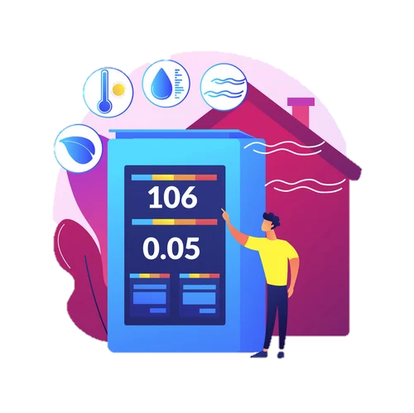
PureAir
Breathing Life into Learning: The IoT Revolution in Classroom Ventilation
Project By
Hadar Asher 207767005

Slide 2
Indoor Air Quality
Poor ventilation
Allergans
PureAir
Dispersal of diseases
Old ventilation system
Mold and Mildew Growth
Air Quality Concerns
Notes:
In response to the heightened awareness of air borne diseases like COVID-19 and seasonal flu, the project focuses on developing a smart ventilation system for classrooms. By leveraging IoT technology, the system monitors and regulates indoor air quality in real-time, addressing the pressing need for safer and healthier learning environments.

Slide 3
Indoor Air Quality
Notes:
The normal values for air quality parameters can vary depending on several factors such as the specific environment, ventilation, and the presence of pollutants. However, for indoor environments like classrooms, here are some general guidelines for acceptable air quality levels:
Total Volatile Organic Compounds (TVOCs):
Normal Range: 0 - 300 parts per billion (ppb)
TVOC levels above 300 ppb may indicate elevated indoor air pollution, possibly due to off-gassing from building materials, cleaning products, or other sources.
Equivalent Carbon Dioxide (eCO2):
Normal Range: 400 - 1,000 parts per million (ppm)
eCO2 levels above 1,000 ppm may indicate inadequate ventilation and the accumulation of exhaled carbon dioxide, potentially leading to stuffiness and discomfort.
Particulate Matter (PM2.5 and PM10):
Normal Range: PM2.5 < 25 µg/m³, PM10 < 50 µg/m³ (24-hour average)
Elevated levels of particulate matter can indicate poor indoor air quality, especially if originating from sources such as dust, pollen, or outdoor pollution infiltration.
Carbon Monoxide (CO):
Normal Range: 0 - 9 parts per million (ppm) (8-hour average)
Carbon monoxide levels above 9 ppm may indicate incomplete combustion from gas appliances or vehicle exhaust, posing a health risk to occupants.
Ozone (O3):
Normal Range: 0 - 100 parts per billion (ppb) (8-hour average)
Ozone levels above 100 ppb may indicate elevated outdoor pollution levels or indoor sources such as air purifiers or photocopiers.
These are approximate guideline values, and it's essential to consider specific regulatory standards and recommendations for indoor air quality in your region. Additionally, factors such as occupant sensitivity and comfort preferences may influence alert thresholds for the smart ventilation system. Therefore, it's advisable to consult with environmental health experts or refer to local guidelines to determine appropriate threshold values for air quality alerts in classroom environments.

Slide 4
Goal of the Project
The goal is to create a smart ventilation system that optimizes air quality and comfort levels in classrooms. Through sensor-based monitoring and autonomous control of window openings, our system aims to mitigate the risk of airborne disease transmission and promote a conducive learning environment for students and educators.

Slide 5
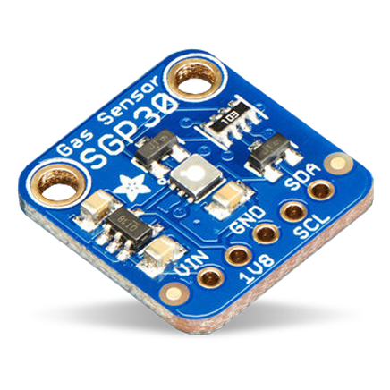
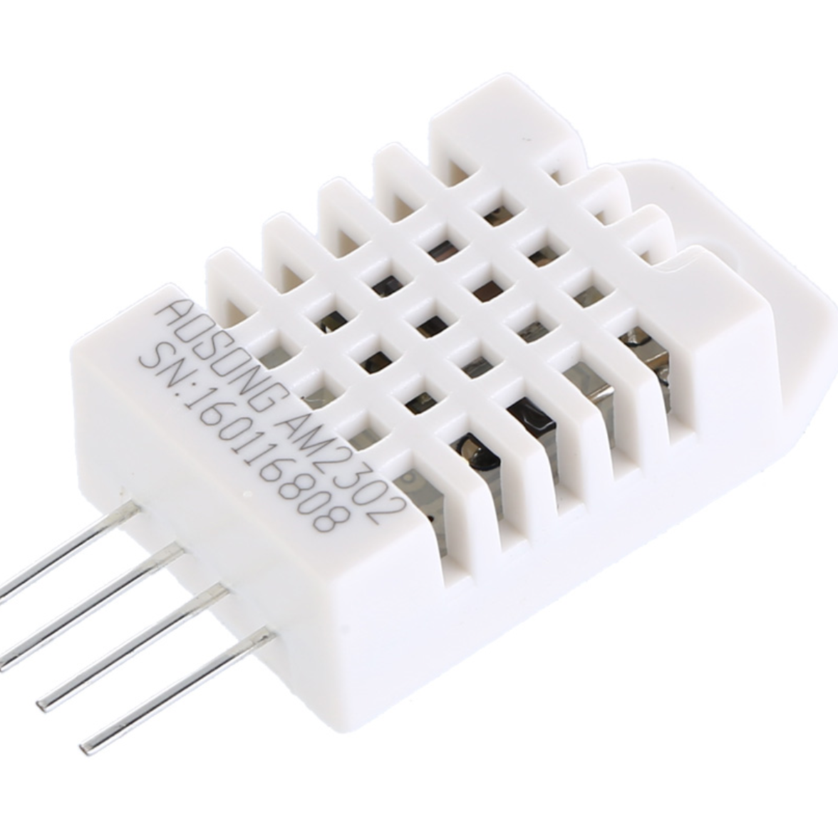
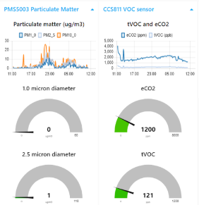
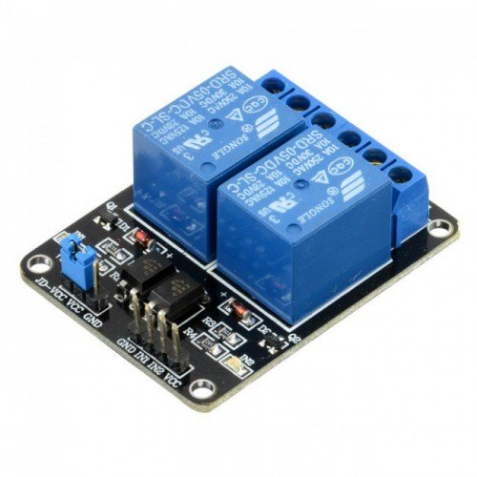
System Modules
Air Quality Sensor (AQS)
DHT Sensor
Teacher Dashboard
Relay sensor
Sensirion SGP30 sensor - measures total volatile organic compounds (TVOCs) and equivalent carbon dioxide (eCO2) levels in the air.
DHT22 sensor –
monitors humidity and temperature levels in classrooms. It offers high accuracy and stability, making it suitable for indoor environmental monitoring applications.
Application that enables teachers to monitor sensor data, receive alerts for air quality concerns, and manually control window openings/closures, all via a desktop application on their computers.
Songle SRD-05VDC-SL-C relay module –
Controls the status of windows based on commands received from the teacher dashboard.

Slide 6





How it Works?
MQTT
Broker
Publish
data
Close/Open commands
Subscribe sensors
data
Publish commands
Windows
status

Slide 7
Functionality and Flow
Sensor in class collect information about temperature, humidity, TVOCs and eCO2 levels in class.
The teachers’ app subscribed to the broker and get the values and save to DB.
If the teacher will decide to open the windows, he will click on the button on the app.
The relay module is subscribed to the broker and get the open/close command.
If Auto mode – will publish open the windows
Every 10 minutes the sensor will publish the current data to the MQTT broker
If there is a abnormal value – get alert on teachers’ app.
The button click will publish open/close.
The relay connected to the window an opens or close it.

Slide 8
Design and Development stages
Stage 1
Stage 2
Purchase Sensors and Build Integrated Sensor Unit
Create a Cloud Program with MQTT Protocol – on ThingsBoard Cloud
Stage 3
Stage 4
Develop Teacher Application, sensors program and window controller program
Implement Data Transmission and Connection Features
Stage 5
Stage 6
Prototype Integration and Testing
Initiate Pilot Deployment and Evaluation

Slide 9

Work Flows
MQTT
Broker
High value
Publish
data
Open command
MQTT
Broker
Open command
AUTO MODE
Open/Close command
MQTT
Broker
Open/Close command
MANUAL MODE

Slide 10
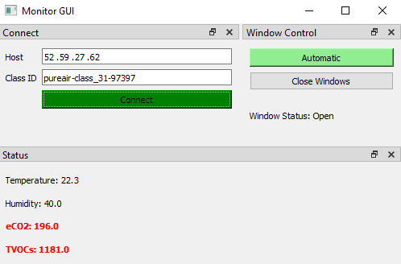
UI – main modules
Mode control
Auto/Manual
connection
Open/close
button
Current status
Current values in class

Slide 11
Summary and Conclusions
The project aims to develop a smart ventilation system for classrooms, leveraging IoT technology to monitor and regulate indoor air quality in real-time. By integrating air quality and DHT sensors with a relay module, data is transmitted to a cloud-based program via MQTT protocol. Teachers can access a custom application to monitor sensor data and control ventilation settings, ensuring safer and healthier learning environments.
This smart ventilation system represents a significant advancement in creating safer classrooms. Moving forward, further refinements based on user feedback will optimize system performance, fostering widespread adoption and promoting a culture of health and safety in schools.

Slide 12
Bibliography
https://theconversation.com/investing-in-indoor-air-quality-improvements-in-schools-will-reduce-covid-transmission-and-help-students-learn-191410
https://www.nytimes.com/wirecutter/reviews/best-home-air-quality-monitor/
https://www.epa.gov/indoor-air-quality-iaq/air-sensor-technology-and-indoor-air-quality
https://iotacommunications.com/portfolio/indoor-air-quality-parameters/

